Slide 1
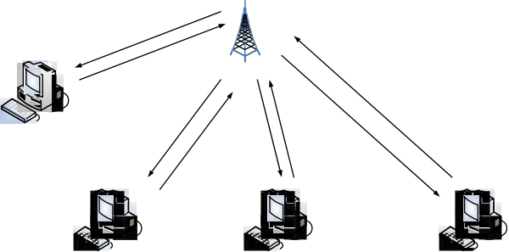
ALOHA

Slide 2
ALOHA Background
Communication medium
Modern Local Area Networks (LANs) operate as follows:
Users are connected to communication medium, e.g. a wire, radio spectrum, etc.
When user A sends a message to user B, the message is broadcast to the medium and
1. If no one else is broadcasting at the same time, every user on the LAN hears the message.
2. If another user is broadcasting at the same time, then the message interfere (collide) with each other and no user on the LAN receives the individual message.
A
–
–
B
C

Slide 3
What is ALOHA?
ALOHA is a system for coordinating and arbitrating access to a shared communication Networks channel.
It was developed in the 1970s by Norman Abramson and his colleagues at the University of Hawaii. The original system used for ground based Radio broadcasting, but the system has been implemented in satellite communication systems.
The computers of the ALOHA network transmit on the same radio channel whenever they have a packet to transmit.
ALOHA is the father of multiple access protocols at the datalink layer and proposes how multiple terminals access the medium without interference or collision.
In the ALOHA system, a node transmits whenever data is available to send.
If another node transmits at the same time, a collision occurs, and the frames
that were transmitted are lost.

Slide 4

ALOHA Model
• Definitions and assumptions
– X: frame transmission time (assume constant).
– S: throughput (average # successful frame transmissions per X seconds).
– G: load (average # transmission attempts per X sec).
– Psuccess : probability a frame transmission is successful.
S = GPsuccess
Any transmission that
begins during vulnerable period leads to collision.
X X
Success if no arrivals during 2X seconds.
Prior interval frame
transmission

Slide 5
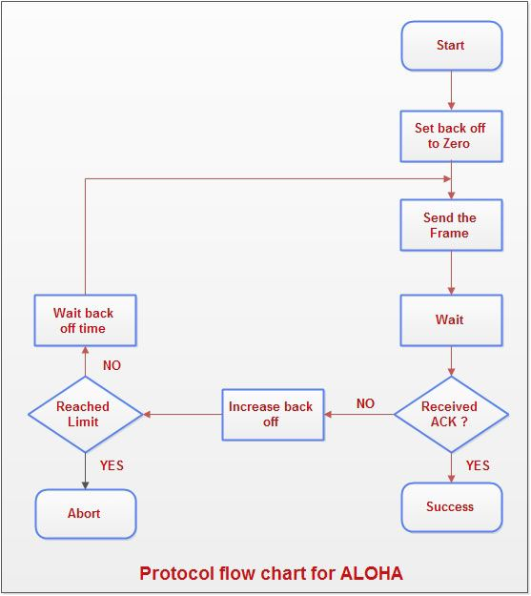
ALOHA protocol
1. A user transmits whenever it has data to transmit.
2. If more than one frames are transmitted, they interfere with each other (collide) and are lost.
3. If ACK not received within timeout, then a user picks random
Back off time (to avoid repeated collision).
4. User retransmits frame after back off time.
First transmission Retransmission
Backoff period B
t
t0-X
t
t0+X
t0+X+2tprop
t0+X+2tprop
+ B
0
Time-out

Slide 6
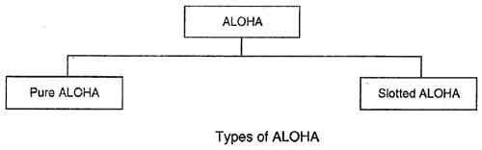

Types of ALOHA
There are two different versions of ALOHA :
1)PURE ALOHA, 2)SLOTTED ALOHA.
Pure ALOHA :
• In pure ALOHA, the stations transmit frames whenever they have data to send.
• When two or more stations transmit simultaneously, there is collision and the frames are destroyed.
• In pure ALOHA, whenever any station transmits a frame, it expects the acknowledgement from the
receiver.
• If acknowledgement is not received within specified time, the station assumes that the frame
(or acknowledgement) has been destroyed.
Slotted ALOHA:
• Slotted ALOHA was invented to improve the efficiency of pure ALOHA as chances of collision in
pure ALOHA are very high.
• In slotted ALOHA, the time of the shared channel is divided into discrete intervals called slots.
• The stations can send a frame only at the beginning of the slot and only one frame is sent in each slot.

Slide 7
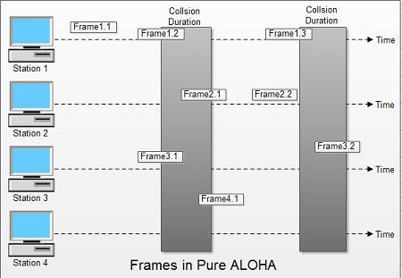
Frames in Pure ALOHA
• In fig there are four stations that .contended with one another for access to shared channel. All these stations are transmitting frames. Some of these frames collide because multiple frames are in contention for the shared channel.
Only two frames, frame 1.1 and frame 2.2 survive. All other frames are destroyed.
• Whenever two frames try to occupy the channel at the same time, there will be a collision and both will be damaged. If first bit of a new frame overlaps with just the last bit of a frame almost finished ,both frames will be totally destroyed and both will have to be retransmitted.

Slide 8
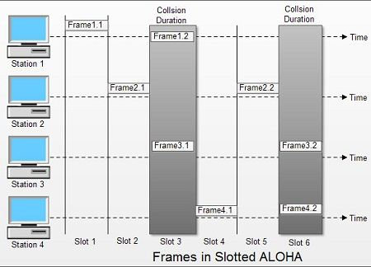
Frames in Slotted ALOHA
• In slotted ALOHA, if any station is not able to place the frame on to the channel at the beginning
of the slot i.e. it misses the time slot then the station has to wait until the beginning of the next time slot.
• In slotted ALOHA, there is still a possibility of collision if two stations try to send at the beginning of the same time slot as shown in fig.
• Slotted ALOHA still has an edge over pure ALOHA as chances of collision are reduced to one-half.

Slide 9
Explanation:
• A station which has a frame ready will send it.
• Then it waits for some time.
• If it receives the acknowledgement then the transmission is successful.
• Otherwise the station uses a back off strategy, and sends the packet again.
• After many times if there is no acknowledgement then the station aborts the idea of transmission.

Slide 10
THANK YOU
NAME : ABHIJIT MONDAL
STREAM : COMPUTER SCIENCE & ENGINEERING
ROLL NO : 16800117063
YEAR : 3rd
SEMESTER : 6th
SUBJECT : COMPUTER NETWORK ASSIGNMENT

